Slide 1
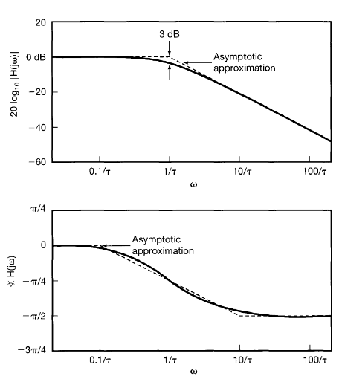


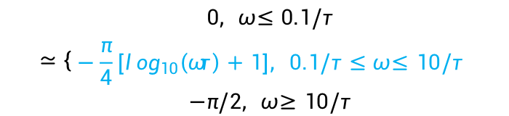

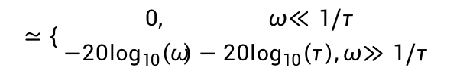


6.5 First- and second-order systems
First-order CT system
$$H\left(jω\right)=\frac{1}{jωτ+1}$$
$$20\log_{10}\left|H\left(jω\right)\right|=−10\log_{10}[{\left(ωτ\right)}^{2}+1]$$
$$≃\left\{ \begin{matrix}0, ω≪1/τ \\ −20\log_{10}\left(ω\right)−20\log_{10}\left(τ\right),ω≫1/τ \end{matrix}\right.$$
20-dB-per-decade
$$ω=1/τ\text{, }20\log_{10}\left|H\left(jω\right)\right|=−10\log_{10}\left(2\right)≃−3dB$$
$ω=1/τ：$break frequency
$$∠H\left(jω\right)=−\tan^{−1}(ωτ)$$
$$≃\left\{ \begin{matrix}0, ω≤0.1/τ \\ −\frac{π}{4}\left[\log_{10}\left(ωτ\right)+1\right], 0.1/τ≤ω≤10/τ \\ −π/2, ω≥10/τ\end{matrix} \right.$$
$$Why?$$
$$ω=1/τ\text{, }∠H\left(jω\right)=−π/4$$

Slide 2
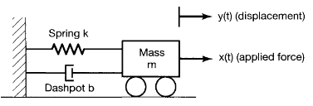




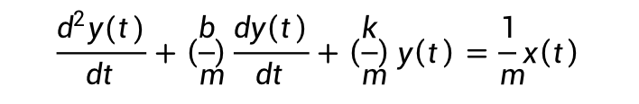
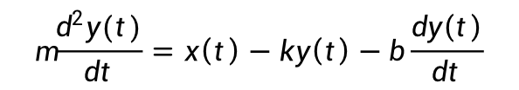
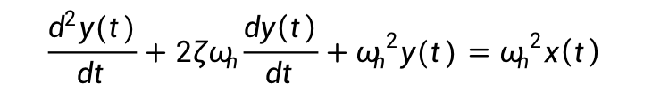
6.5 First- and second-order systems
Second-order CT system: differential equation
Differential equation
$$\frac{d^{2}y(t)}{dt}+2ζω_{n}\frac{dy\left(t\right)}{dt}+{ω_{n}}^{2}y(t)={ω_{n}}^{2}x\left(t\right)$$
$${ω_{n}}^{2}=\frac{k}{m}$$
$$ω_{n}=\sqrt{\frac{k}{m}}$$
$$ζ=\frac{b}{2\sqrt{km}}$$
$$m\frac{d^{2}y(t)}{dt}=x\left(t\right)−ky\left(t\right)−b\frac{dy\left(t\right)}{dt}$$
$$2ζω_{n}=\frac{b}{m}$$
$$\frac{d^{2}y(t)}{dt}+\left(\frac{b}{m}\right)\frac{dy\left(t\right)}{dt}+\left(\frac{k}{m}\right)y\left(t\right)=\frac{1}{m}x\left(t\right)$$

Slide 3


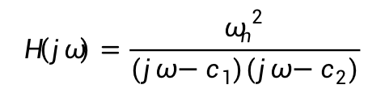

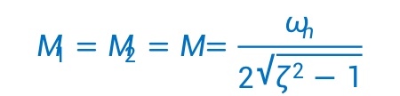
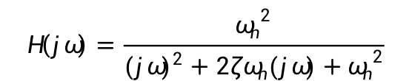
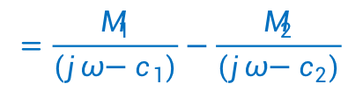

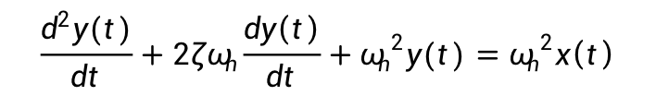
6.5 First- and second-order systems
Second-order CT system: impulse response
Frequency response
$$\frac{d^{2}y(t)}{dt}+2ζω_{n}\frac{dy\left(t\right)}{dt}+{ω_{n}}^{2}y(t)={ω_{n}}^{2}x\left(t\right)$$
$${(jω)}^{2}Y(jω)+2ζω_{n}(jω)Y(jω)+{ω_{n}}^{2}Y(jω)={ω_{n}}^{2}X(jω)$$
$$H\left(jω\right)=\frac{{ω_{n}}^{2}}{{(jω)}^{2}+2ζω_{n}(jω)+{ω_{n}}^{2}}$$
partial-fraction expansion
Impulse response
$$H\left(jω\right)=\frac{{ω_{n}}^{2}}{(jω−c_{1})(jω−c_{2})}$$
$$=\frac{M_{1}}{(jω−c_{1})}−\frac{M_{2}}{(jω−c_{2})}$$
$${c_{1},c_{2}:roots of (jω)}^{2}+2ζω_{n}\left(jω\right)+{ω_{n}}^{2}=0$$
$$ζ≠1$$
$$c_{1}=−ζω_{n}+ω_{n}\sqrt{ζ^{2}−1},{ c}_{2}=−ζω_{n}−ω_{n}\sqrt{ζ^{2}−1}$$
$${M_{1}(jω−c}_{2})−{M_{2}(jω−c}_{1})={ω_{n}}^{2}$$
$${M(c_{1}−c}_{2})={ω_{n}}^{2}$$
$$M_{1}=M_{2}=M=\frac{ω_{n}}{2\sqrt{ζ^{2}−1}}$$
$$h\left(t\right)=M[e^{c_{1}t}−e^{c_{2}t}]u(t)$$

Slide 4

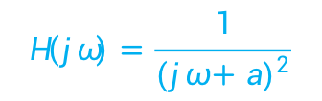

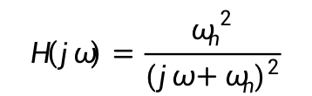





6.5 First- and second-order systems
Second-order CT system: impulse response
Frequency response
$$\frac{d^{2}y(t)}{dt}+2ζω_{n}\frac{dy\left(t\right)}{dt}+{ω_{n}}^{2}y(t)={ω_{n}}^{2}x\left(t\right)$$
$${(jω)}^{2}Y(jω)+2ζω_{n}(jω)Y(jω)+{ω_{n}}^{2}Y(jω)={ω_{n}}^{2}X(jω)$$
$$H\left(jω\right)=\frac{{ω_{n}}^{2}}{{(jω)}^{2}+2ζω_{n}(jω)+{ω_{n}}^{2}}$$
partial-fraction expansion
Impulse response
$$H\left(jω\right)=\frac{{ω_{n}}^{2}}{{(jω+ω_{n})}^{2}}$$
$$ζ=1$$
$$c_{1}=c_{1}=−ω_{n}$$
$$ℱ$$
$$H\left(jω\right)=\frac{1}{jω+a}$$
$$e^{−at}u(t)$$
$$ℱ$$
$$H\left(jω\right)=\frac{1}{{(jω+a)}^{2}}$$
$${te}^{−at}u(t)$$
$$h\left(t\right)={ω_{n}}^{2}{te}^{{−ω}_{n}t}u(t)$$

Slide 5




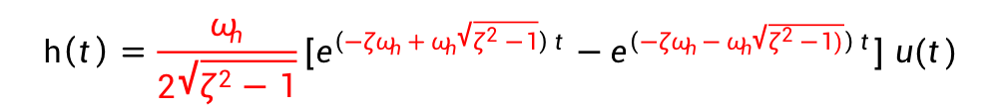


6.5 First- and second-order systems
Second-order CT system: impulse response
Impulse response
$$ζ≠1$$
$$h\left(t\right)=M[e^{c_{1}t}−e^{c_{2}t}]u(t)$$
$$h\left(t\right)=\frac{ω_{n}}{2\sqrt{ζ^{2}−1}}[e^{\left(−ζω_{n}+ω_{n}\sqrt{ζ^{2}−1}\right)t}−e^{\left(−ζω_{n}−ω_{n}\sqrt{ζ^{2}−1)}\right)t}] u(t)$$
$$0<ζ<1$$
$$=\frac{ω_{n}e^{−ζω_{n}t}}{2\sqrt{ζ^{2}−1}}\left[e^{{jω}_{n}\sqrt{{1−ζ}^{2}}t}−e^{−{jω}_{n}\sqrt{{1−ζ}^{2}}t}\right]u(t)$$
$$=\frac{ω_{n}e^{−ζω_{n}t}}{2\sqrt{ζ^{2}−1}}[2j\sin{{(ω}_{n}\sqrt{{1−ζ}^{2}}}t)]u(t)$$
$$h\left(t\right)=\frac{ω_{n}e^{−ζω_{n}t}}{\sqrt{{1−ζ}^{2}}}[\sin{{(ω}_{n}\sqrt{{1−ζ}^{2}}}t)]u(t)$$
$$ζ>1?$$

Slide 6
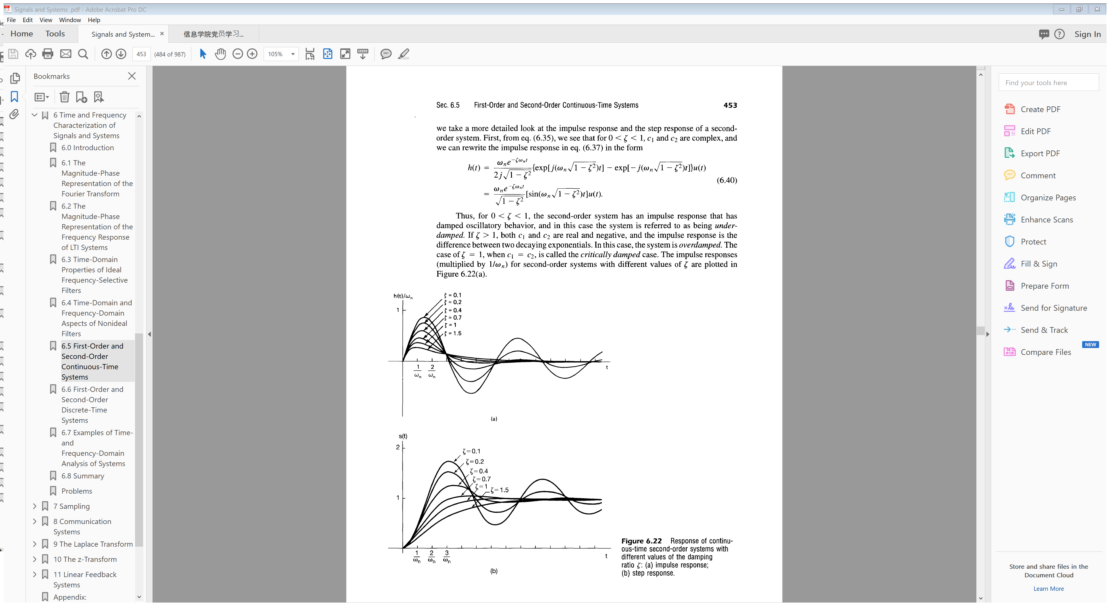



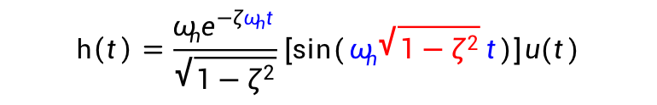




6.5 First- and second-order systems
Second-order CT system: impulse response
$ω_{n}$: un-damped natural frequency
$ζ$: damping ratio
$0<ζ<1$: damped
$$h\left(t\right)=\frac{ω_{n}e^{−ζω_{n}t}}{\sqrt{{1−ζ}^{2}}}[sin({ω_{n}\sqrt{{1−ζ}^{2}}}t)]u(t)$$
$ζ=1$: critically damped
$$h\left(t\right)={ω_{n}}^{2}{te}^{{−ω}_{n}t}u(t)$$
$ζ>1$: overdamped
$$h\left(t\right)=M[e^{c_{1}t}−e^{c_{2}t}]u(t)$$

Slide 7
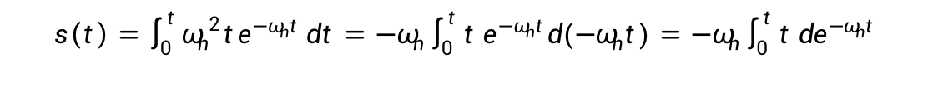

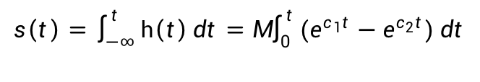
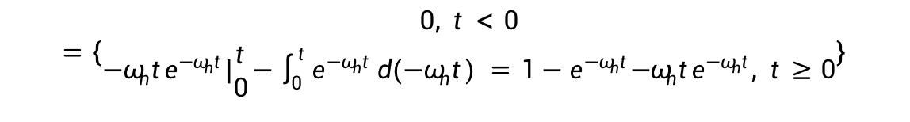
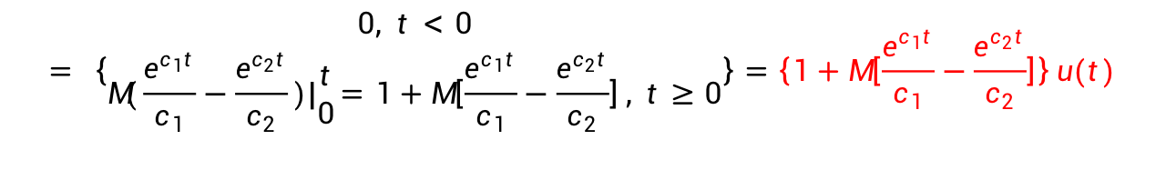



6.5 First- and second-order systems
Second-order CT system: Step response
$$ζ≠1$$
$$h\left(t\right)=M[e^{c_{1}t}−e^{c_{2}t}]u(t)$$
$$s\left(t\right)=\int_{−∞}^{t}{h\left(t\right)}dt=M\int_{0}^{t}{{(e}^{c_{1}t}−e^{c_{2}t})}dt$$
$$= \left\{\begin{matrix}0, t<0 \\ M(\frac{e^{c_{1}t}}{c_{1}}−\frac{e^{c_{2}t}}{c_{2}})|\begin{matrix}t \\ 0\end{matrix}=1+M\left[\frac{e^{c_{1}t}}{c_{1}}−\frac{e^{c_{2}t}}{c_{2}}\right], t≥0\end{matrix}\right\}=\left\{1+M\left[\frac{e^{c_{1}t}}{c_{1}}−\frac{e^{c_{2}t}}{c_{2}}\right]\right\}u(t)$$
$$ζ=1$$
$$h\left(t\right)={ω_{n}}^{2}{te}^{{−ω}_{n}t}u(t)$$
$$s\left(t\right)=\int_{0}^{t}{{ω_{n}}^{2}{te}^{{−ω}_{n}t}}dt={−ω}_{n}\int_{0}^{t}{t}e^{{−ω}_{n}t}d(−ω_{n}t)={−ω}_{n}\int_{0}^{t}{t}de^{{−ω}_{n}t}$$
$$=\left\{\begin{matrix}0, t<0 \\ {−ω}_{n}te^{{−ω}_{n}t}|\begin{matrix}t \\ 0\end{matrix}−\int_{0}^{t}{e^{{−ω}_{n}t}}d(−ω_{n}t) =1−e^{{−ω}_{n}t}{−ω}_{n}te^{{−ω}_{n}t}, t≥0\end{matrix}\right\}$$
$$s\left(t\right)=[1−e^{{−ω}_{n}t}{−ω}_{n}te^{{−ω}_{n}t}]u(t)$$

Slide 8


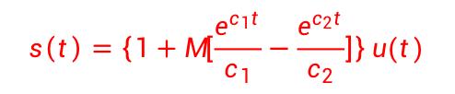

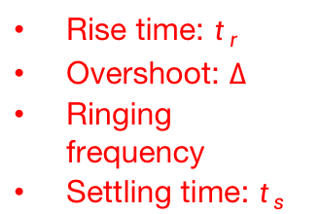
6.5 First- and second-order systems
Second-order CT system: Step response
Rise time: $t_{r}$
Overshoot: $∆$
Ringing frequency
Settling time: $t_{s}$
$$s\left(t\right)=\left\{1+M\left[\frac{e^{c_{1}t}}{c_{1}}−\frac{e^{c_{2}t}}{c_{2}}\right]\right\}u(t)$$
$$ζ≠1$$
$$ζ=1$$
$$s\left(t\right)=[1−e^{{−ω}_{n}t}{−ω}_{n}te^{{−ω}_{n}t}]u(t)$$
$ζ>1, ζ↑, step response slow down.$ Why?

